Slide 1
POH-GGZ, 8-12-2016
Jim van Os
Notes:
1

Slide 2
Geneeskunde: Ongebreidelde Specialisatie?
Notes:
2

Slide 3
Notes:
Sjef Czyzewski:

Slide 4
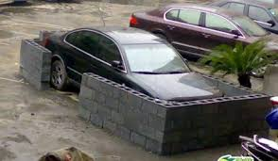
GGZ: De Sectorale Ontwikkeling
Notes:
4

Slide 5
Verwijzen naar de GGZ….
Geachte collega,
Meneer X klaagt over hevige angsten en paniek, gaarne uw diagnose en behandeling

Slide 6
Verwijzen naar de GGZ….
Nee het is depressie…..ander zorgpad
Nee het is psychose…..ander zorgpad
Nee het is verslaving….ander zorgpad
Nee het is persoonlijkheid….ander zorgpad
Nee het is autisme….ander zorgpad

Slide 7
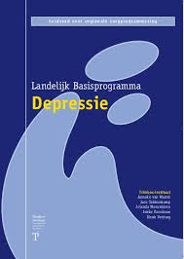
Multidisciplinaire richtlijnen
Notes:
7

Slide 8
Notes:
8

Slide 9
DSM : Diagnosis for many
302.82
303.90
316.00
290.10
307.42
495.40
45%
25%
295.30
V71.09
525.70
307.30
525.70
780.52
312.09
294.80
720.05
625.80
V62.89
Notes:
9

Slide 10
‘Marktwerking’: Explosie in ggz
3.5%
2004
2.4 miljard
7.0%
2010
7.0 miljard

Slide 11
Onder- en Overbehandeling
OVER-behandeling
ONDER-behandeling

Slide 12
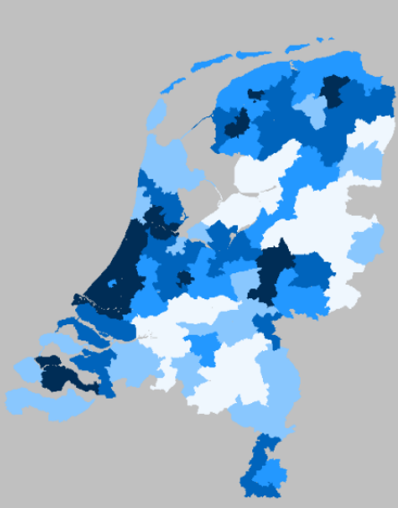
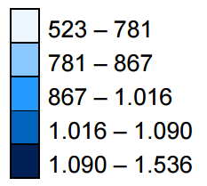
Angst/Depressie behandeling: aanbod gedreven

Slide 13
1 FACT Team (8-9 FTE)
40-50.000 population
Notes:
13

Slide 14
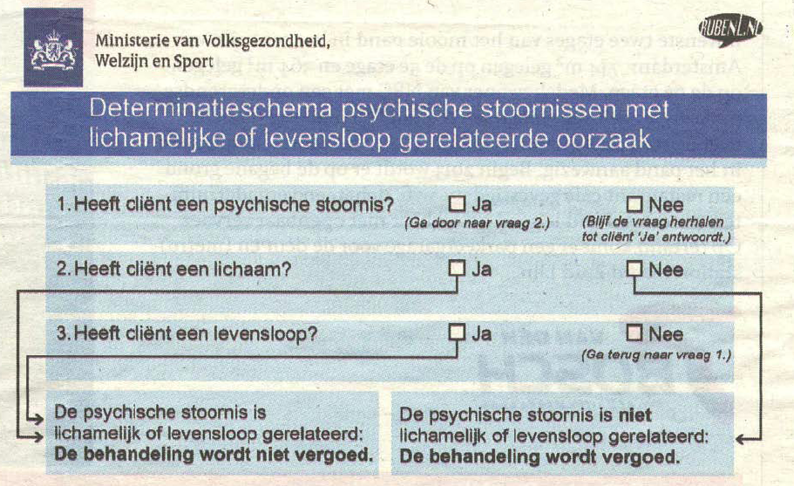
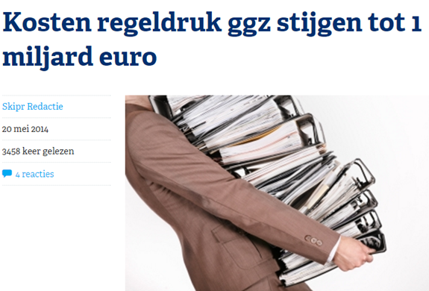
Reducing Costs

Slide 15
Professionals over de gevolgen van marktwerking
Nienke van Sambeek, Evelien Tonkens & Christian Bröer, 2011

Slide 16
Mobile Health (mHealth)
Notes:
Het is niet eenvoudig, om deze processen in kaart te brengen. Onderzoek naar persoons-omgevingsinteracties zijn over de afgelopen 25 jaar door onze vakgroep uitgevoerd, met de experience sampling methode. Oorspronkelijk ontwikkeld als een papier en potlood technologie met een alarm horloge, is deze dataverzameling recent door de mobiele computertechnologie vereenvoudigd. Ik heb de PsyMate ontwikkeld, om in het dagelijkse leven, herhaaldelijk informatie te verzamelen over cognities, stemming, perceptie en gedrag. Op toevallige momenten doorheen de dag krijg je een signaal om een vragenlijst in te vullen. Je krijgt 20 tot 40 vragen per keer, maar moet ze binnen 2 minuten invullen. Hierdoor wordt het normale functioneren in het dagelijkse leven slechts minimaal verstoord.

Slide 17
3 pijlers van Nieuwe GGZ
een visie
op
kennis
een visie
op
middelen
een visie
op
cultuur

Slide 18
Gezondheid = Eigen regie
WHO, 1948
Huber, 2011
Symptoombe-strijding
Je ding kunnen doen - ondanks uitdagingen

Slide 19
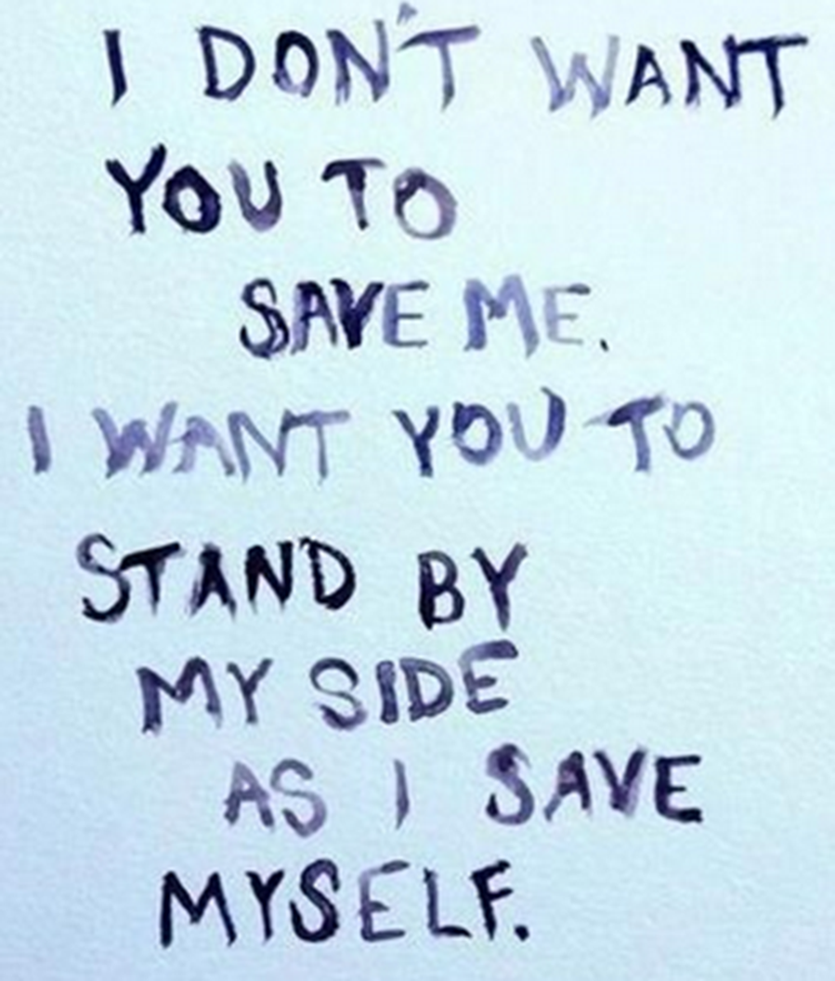
Notes:
Belofte uit de ambigue datapool van de biologische psychiatrie

Slide 20
CHIME: Voorbij Symptoomscores
CONNECTEDNESS; HOPE AND OPTIMISM; IDENTITY; MEANING IN LIFE; EMPOWERMENT
……..point to the need for a greater emphasis on assessment of strengths and support for self-narrative development, promoting the role of mental health systems in developing inclusive communities enabling access to peer support as well as providing retreats, and clinical interaction styles which promote empowerment and self-management.
Leamey et al, 2011
Notes:
20
WHEN the musician Lucinda Williams was shopping around an early demo tape of what would become her self-titled album, she was at first turned down by all the record labels she tried.
“At Sony records here in L.A.,” she said, they told her “ ‘it’s too country for rock, and so we sent it to Nashville.’ ” In Nashville, they said, “it’s too rock for country.”
Her album was eventually released by Rough Trade Records — an English record company better known for punk and indy music — but it became a touchstone in an entirely new genre: “alt-country” (“whatever that is,” in the cheeky refrain of the movement’s chronicling magazine, No Depression).
The artist struggling against easy categorization is an old trope. It virtually defined the career of Prince, who surmounted any number of categorical divisions. Through talent and hubris, he became his own category, a magical blur exemplified by his symbolical glyph.
We listeners are endless and instinctual categorizers, allotting everything its spot like bins in a record store. The human brain is a pattern-matching machine. Categories help us manage the torrent of information we receive and sort the world into easier-to-read patterns.
When we see a rainbow, note the psychologists James Beale and Frank Keil, we see it as distinct bands of colors, rather than the “gradual continuum we know it to be.” Even though two colors may be the same distance apart in terms of wavelength, we can distinguish them more easily when they cross a color category.
This “categorical perception,” as it’s called, is not an innocent process: What we think we’re looking at can alter what we actually see. More broadly, when we put things into a category, research has found, they actually become more alike in our minds.
“Similarity serves as a basis for the classification of objects,” wrote the noted psychologist Amos Tversky, “but it is also influenced by the adopted classification.” The flip side holds: Things we might have viewed as more similar become, when placed into two distinct categories, more different.
Genre is also the way we most commonly make sense of music. But here, too, a form of categorical perception reigns.
At the Echo Nest, a “music intelligence” company owned by Spotify, a software engineer named Glenn McDonald has created a sprawling map of musical genres called “Every Noise at Once.” At last count, he had identified more than 1,400 genres — including those old favorites “future garage” and “symphonic black metal.”
Even though a computer might struggle to see a strong difference between two forms of music, humans seem intent on finding one. As an example of two genres where the music sounds quite alike but isn’t, Mr. McDonald cites “vegan straight edge” versus “hatecore.” If you didn’t know the categories, you might have trouble telling them apart — but meet the two groups of fans and the difference would be pretty apparent.
This also tells us that, very often, these distinctions are for social purposes: People label music, music labels people. As with the rainbow, a country song and a rock song might be musically closer than two songs withineither genre, but in our minds, the genre threshold takes precedence.
Categorization affects not just how we perceive things, but how we feel about them. When we like something, we seem to want to break it down into further categories, away from the so-called basic level. Birders do not just see “birds,” gardeners do not just see “flowers”; they see specific variations. The more we like something, the more we like to categorize it.
As the psychology professor Debra Zellner has found, people who put drinks like coffee or beer into particular categories actually liked the everyday beverages more than the people who simply labeled everything as undifferentiated “beer” or “coffee.” Thus one online reviewer at the site BeerAdvocate described a brew as a “perfect lawn mower beer.” Is it the best beer ever? No. Is it good enough on a hot day after sweaty yardwork? Absolutely.
These connoisseurs experienced less “hedonic contrast” — the “lawn mower” beer might suffer by comparison with a Belgian saison, but rise in a drinker’s estimation if it were simply lumped with other beers of its type.
When we struggle to categorize something, we like it less. In a study recently published in the Journal of Experimental Psychology, the subjects were shown a variety of “gender-ambiguous” morphed images of men and women.
One group was asked just to evaluate the attractiveness of the figure in each photo; another group was asked to first classify the people in the photos by gender, and then rate attractiveness. The first group tended to prefer faces that appeared more feminine, but the second group found all the morphed faces relatively unattractive.
The mental work of classifying hard-to-classify stimuli seemed to produce “cognitive disfluency,” and this effort, the researchers speculated, produced “negative affect that transferred to the face itself.”
Even if we seem to like easy categorization, we’re not rigid about the categories themselves. A few decades ago, for example, the idea of beer in America meant a pale-colored lager, strongly carbonated, low in alcohol and lacking flavor. Following the craft beer revolution, the very category of beer has expanded enormously, with any number of subcategories.
Anyone who still adheres to the old idea of beer will probably experience that cognitive disfluency — and a bad taste — when sampling an extremely hoppy India pale ale or a sour Belgian lambic. To some drinkers, it may not even be beer.
Categories can help us enjoy things for what they are. When existing categories do not suffice, we simply invent new ones. Take the curated rows on the home page of Netflix users: Based on the user history, they feature quirky micro-genres (like “Emotional Fight-the-System Documentaries” or “Foreign Satanic Stories from the 1980s”) as a way to more easily corral, for the viewer’s mind, hard-to-classify material.
The great peril of this reliance on categorizing is that we could miss something that lies outside our perception. There are many examples of films — like “Blade Runner” or “The Big Lebowski” — that received, at best, mixed receptions upon release, probably because they were hard to place, hard to explain.

Slide 21
Suggestie voor noodzaak van:
1. Kleinschaligheid – HA + WMO
2. Relaties
3. Weerbaarheidsbevordering
4. (e)Community
Notes:
21
Schaarsteverdeling in de wijk - ZICHTBAAR

Slide 22
GGZ Geïntegreerd in de Haarvaten van de Wijk
Beperkte regionale voorzieningen
neighbourhood community (100FTE)
neighbourhood community (100FTE)
neighbourhood community (100FTE)
neighbourhood community (100FTE)
neighbourhood community (100FTE)
neighbourhood community (100FTE)
neighbourhood community (100FTE)
neighbourhood community (100FTE)
neighbourhood community (100FTE)
neighbourhood community (100FTE)
neighbourhood community (100FTE)

Slide 23
Verschuiving van Middelen
Notes:
23

Slide 24
Crisis = Netwerken Activeren & Empoweren
Notes:
24

Slide 25
Social Economy

Slide 26
Wat zijn psychische aandoeningen?
Kwetsbaarheden die over het leven periodiek aanleiding geven tot zorgbehoeften en een proces van weerbaarheidsbevordering vragen
Werken
Symptomen
Relaties
Opleiding

Slide 27
Deperso-nalisation
Lack of appetite
Selfre-ference
Anxiety
Compul-sions
Anhedo-nia
Hyper-activity
Fear
Pain
Guilt
Influence
Obses-sions
Hyper-ergia
Hopeless-ness
Transdiagnostische symptomen
Panic
Insomnia
Amnesia
Voices
Intru-sions
Suicida-lity
Inatten-tion
Low mood
Hyper-TOM
Worry
Craving
Avoidan-ce
Worth-less
Impulsi-vity
Rumina-tion
Hypo-mania
Hypo-TOM
Anergia
Dereali-sation
Demora-lisation
Paranoia

Slide 28
Keep it simple (menselijk)
o Psychotisch syndroom
o Bipolair syndroom
o Depressief syndroom
o Angstsyndroom
o Dwangsyndroom
o Trauma syndroom
o Dissociatie syndroom
o Verslavingssyndroom
o Eetsyndroom
o Impulscontrole syndroom
o Neurocognitief syndroom
400
Diagnosen
10-15 Hoofdsyndromen

Slide 29
Persoonlijk Diagnose
Verhaal?
Psychisch syndroom
Dimensies van kwetsbaarheid/kracht?
Doelen?
Zorgbehoeften?

Slide 30
Which Treatment Most Cost-Effective?
Notes:
EU lost 25% of trial business, not USA. Bureaucratic procedures

Slide 31
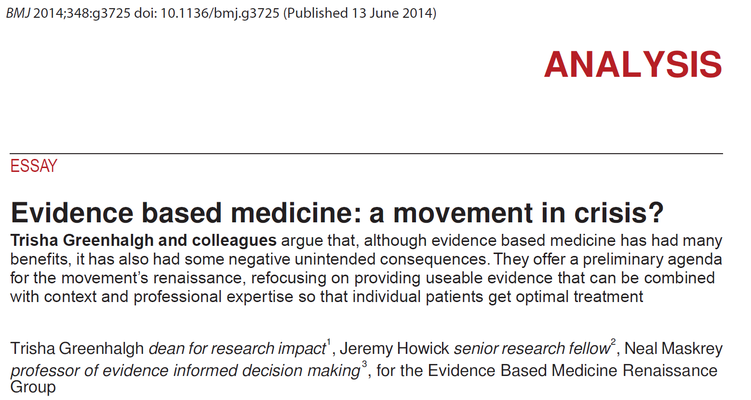
Evidence-based practice: concept in crisis?
JAMA, 2010

Slide 32
Hoeveel wetmatigheid onder de GGZ?
Diagnose
Behandeling
Prognose
Notes:
32

Slide 33
Wat voor soort wetmatigheden onder de GGZ?
LR for a positive test result
LR=10
LR=1.5

Slide 34
Notes:
34

Slide 35
Psychotherapie: verwondering van de Meta-analyticus
Notes:
35
Objective
To investigate staff and trainer perspectives on the barriers and facilitators to implementing a complex intervention to help staff support the recovery of service users with a primary diagnosis of psychosis in community mental health teams.
Design
Process evaluation nested within a cluster randomised controlled trial (RCT).
Participants
28 interviews with mental health care staff, 3 interviews with trainers, 4 focus groups with intervention teams and 28 written trainer reports.
Setting
14 community-based mental health teams in two UK sites (one urban, one semi-rural) who received the intervention.
Results
The factors influencing the implementation of the intervention can be organised under two over-arching themes: Organisational readiness for change and Training effectiveness. Organisational readiness for change comprised three sub-themes: NHS Trust readiness; Team readiness; and Practitioner readiness. Training effectiveness comprised three sub-themes: Engagement strategies; Delivery style and Modelling recovery principles.
Conclusions
Three findings can inform future implementation and evaluation of complex interventions. First, the underlying intervention model predicted that three areas would be important for changing practice: staff skill development; intention to implement; and actual implementation behaviour. This study highlighted the importance of targeting the transition from practitioners' intent to implement to actual implementation behaviour, using experiential learning and target setting. Second, practitioners make inferences about organisational commitment by observing the allocation of resources, Knowledge Performance Indicators and service evaluation outcome measures. These need to be aligned with recovery values, principles and practice. Finally, we recommend the use of organisational readiness tools as an inclusion criteria for selecting bothorganisations and teams in cluster RCTs. We believe this would maximise the likelihood of adequate implementation and hence reduce waste in research expenditure.

Slide 36
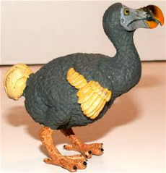
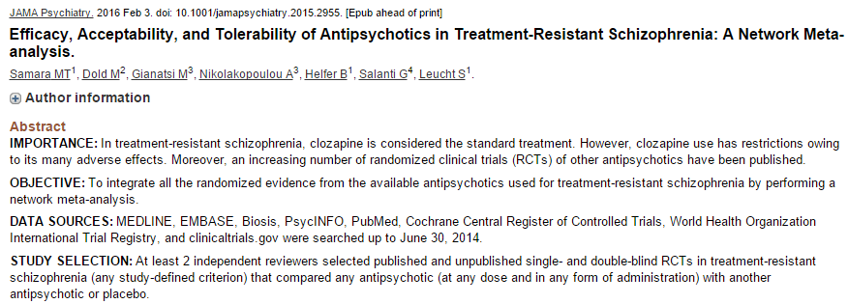
Is Clozapine Superior?
Insufficient evidence exists on which antipsychotic is more efficacious for patients with treatment-resistant schizophrenia, and blinded RCTs-in contrast to unblinded, randomized effectiveness studies-provide little evidence of the superiority of clozapinecompared with other second-generation antipsychotics.

Slide 37
Dodo verklaring: Heterogeniteit?
Therapie A
Therapie B
Therapie C

Slide 38
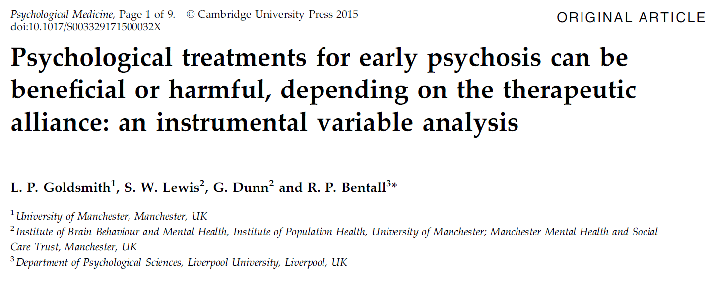
Wat werkt: Relaties onder de behandeling
JAMA, 2010

Slide 39
Clinician “Random Effect”
10%
Re-analysis NIMH Treatment of Depression Collaborative Research Program
5%
% variance BDI antidepressant
% variance BDI psychiatrist
McKay et al, 2006

Slide 40
Nieuwe GGZ in de haarvaten van de wijk
Wijk community
Online Community
Notes:
40

Slide 41
24% jaar prevalentie
eHealth
1-op-1 zorg
eCom-munities
mHealth

Slide 42
eHealth
mHealth
1-op-1 zorg
Zelfmanagement component
eCommunities
1-op-1 component

Slide 43
Conclusies I
GGZ is veel minder ingewikkeld dan men denkt cq voordoet
Transdiagnostische benadering
Persoonlijke (common sense) diagnostiek
Behandeling: n=1 experiment + relationele component

Slide 44
Conclusies II
De GGZ komt naar u toe!
Partner in de wijk
First-name basis
Flexibele op- en afschaling
Werken aan weerbaarheid & somatiek
Public health zelfmanagement
Symptomatisch, Maatschappelijk en Persoonlijk herstel

Slide 45
Fin

Slide 46
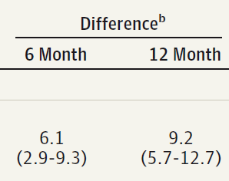
Zelfmanagement = Empowerment
JAMA, 2014
Notes:
46
Pero todo depende del contexto. Es muy facil perder la respectabilidad.

Slide 47
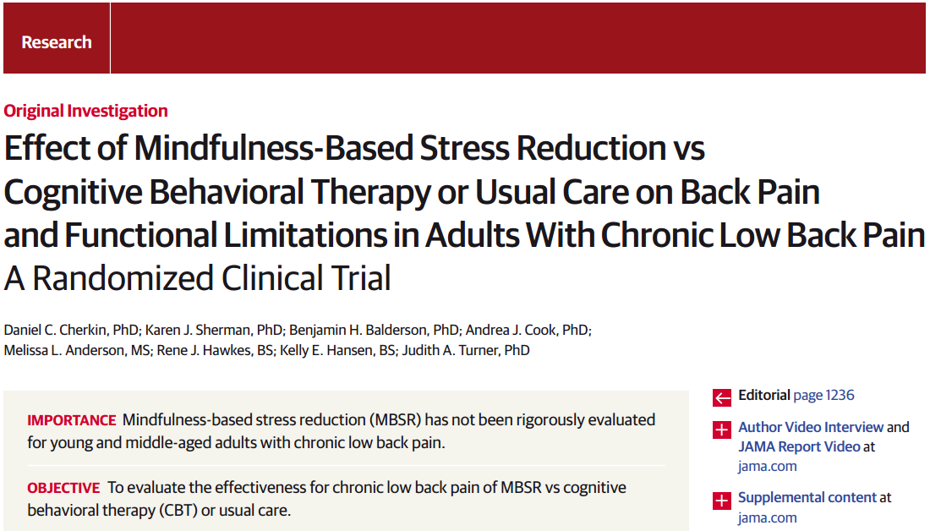
Mind-Body Approaches: Pain

